Slide 1
Functions of Keyboard and Mouse

Slide 2
What is a Computer Keyboard?
Computer tool with the help of which computer text Number of Symbols etc,is inputted.

Slide 3
Who Invented Keyboard?
Christopher Lathom sholes invented the first practical typewriter and the Qwerty keyboard that is Still in use today. He was born on Feb 14, 1819 and died on February 17, 1890 at the age of 71. He was an American inventor.

Slide 4
Categories of Keys on a Keyboard
Function Keys
Navigation Keys
Control Keys
Alphanumeric Keys
Numeric Keypad

Slide 5
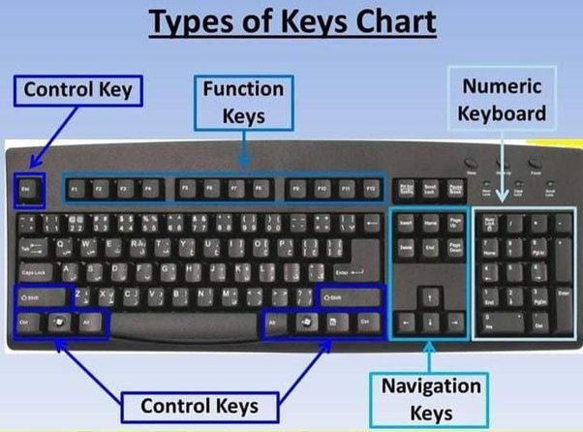

Slide 6
What are the Uses of Keyboard in Computer?
There are five uses of a keyboard in a computer, which are given below.
Input Date
Type Numbers
Text Chatting
Type Special Character
Types computer short cut Keys

Slide 7
Types of Keyboards
Gaming Keyboard
Mechanical Keyboard
Ergonomic Keyboard
Multimedia Keyboard
Hand Keyboard
Flexible Keyboards
Wireless Keyboard
Laptop Keyboard
Laser Virtual Keyboards

Slide 8
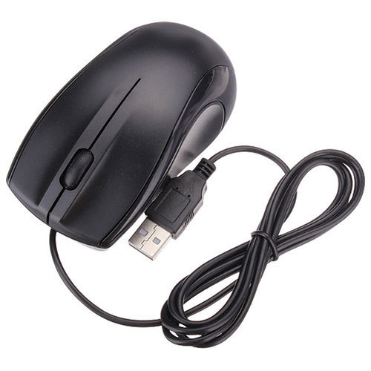
What is Computer Mouse?
A mouse is a pointing input device that controls the movement of the cursor or pointer on a display screen.

Slide 9
Who Invented the Mouse?
Douglas Engelbart invented the mouse while working for Stanford Research Institute (SRI) in 1964.

Slide 10
Types of Mouse
Optical Mouse
Gaming Mouse
Wireless Mouse
Laser Mouse
Trackball Mouse
Ergonomic Mouse
3D Mouse
Mechanical Mouse
Roller Bar Mouse
Finger Mouse
Pen Mouse (Stylus)

Slide 11
What is MS Paint?
Paint is a drawing tool. It is a part of Windows. You can use to create simple or elaborate drawings.

Slide 12
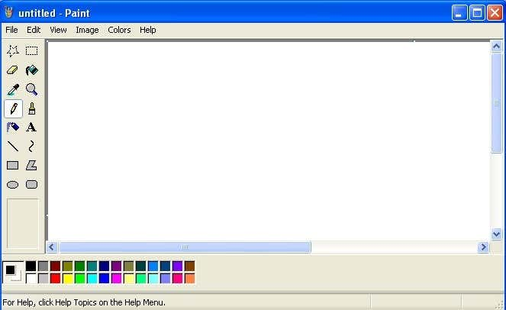

Slide 13
What is Notepad?
Notepad is a generic text editor included with all versions of Microsoft Windows that allows you to create, open, and read plaintext files.

Slide 14
Different text formats
doc and .docx - Microsoft Word file
.odt - OpenOffice Writer document file
.pdf - PDF file
.rtf - Rich Text Format
.tex - A LaTeX document file
.txt - Plain text file
.wpd - WordPerfect document

Slide 15
Thanks For Watching

